Slide 1
Definition
Counterparty risk is the risk that a party to an OTC derivative contract may fail to perform on its contractual obligations, causing losses to the other party.
Losses are usually quantified in terms of the replacement cost of the defaulted derivatives .
Counterparty risk can be:
1
One-Way: One party faces the exposures depending on the (ever positive) value of the position it holds against the other party;
Two-Way: Both parties may face exposures depending on the value of the positions they hold against each other.
2
The feature distinguishing counterparty risk from lending risk is uncertainty of exposure at any future date:
1
Loan: exposure at any future date is the outstanding balance, which is certain (not taking into account prepayments);
Derivative: exposure at any future date is the replacement cost, which is determined by the market value at that date and is, therefore, uncertain.
2

Slide 2
Credit Mitigation Agreements
Agreements between counterparties aim at limiting and reducing the counterparty risk
1
Netting (e.g.: ISDA Master Agreement)
a contract that allows aggregation of transactions;
in the event of default of one of the counterparties, the entire portfolio included in a netting agreement is considered as a single trade.
Collateral Agreements (e.g.: ISDA’s Credit Support Annex (CSA))
collateral is required if unsecured exposure is above a given threshold; threshold and frequency depend on counterparty’s credit quality.
Early termination clauses:
Termination clause: trade-level agreement that allows one (or both) counterparties to terminate the trade at fair market value at a predefined set of dates;
Downgrade provision: portfolio-level agreement that forces the termination of the entire portfolio at fair market value the first time the credit rating of one or of the counterparties falls below a predefined level.
Certain contracts, like Contingent CDS (CCDS).
2
3
4

Slide 3
Counterparty Risk Exposure of a Contract
We start by assuming that no netting or margin agreement is in place.
The market value of contract i with a counterparty is known only for the current date t = 0. For any future date t, the value V_{i} (t) is random.
If the counterparty defaults at time τ_{cpt} before the contract’s maturity, the economic loss is equal to the replacement cost of the contract:
if Vi (τcpt ) > 0, we do not receive anything from defaulting counterparty, but have to pay Vi (taucpt ) to another counterparty to replace the contract;
if Vi (τcpt ) < 0, we receive |Vi (τcpt )| from another counterparty, but have to give this amount to the defaulting counterparty.
Combining these two scenarios, we can specify contract-level exposure E_{i} (t) at time t as:
E_{i} (t) = max[V_{i} (t), 0]

Slide 4
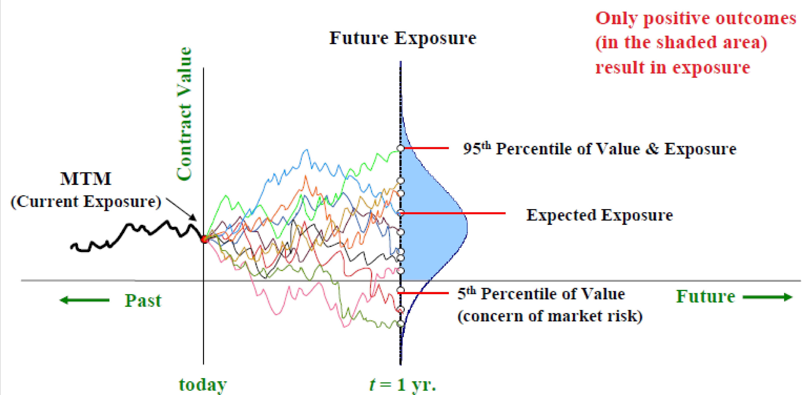
Counterparty Risk Exposure of a Contract
At a future time T > t, the exposure is uncertain:

Slide 5
Counterparty Risk Exposure of a Contract
At any future date t the exposure is a distribution of values.
To obtain this distribution, we must be able to value the contract in the future.
Contract value depends on the market risk factors affecting the derivative: FX rates, interest rates, stock prices, credit spreads... Modeling future exposure is performed in two steps:
1
Scenario generation: simulating correlated risk factors in the future; Valuation: valuing contracts in the future given a realization of risk factors.
2
A counterparty can default at any time in the future, so we need to simulate exposure for a large set (in 100’s) of future time points to describe the Counterparty Credit Risk adequately.

Slide 6
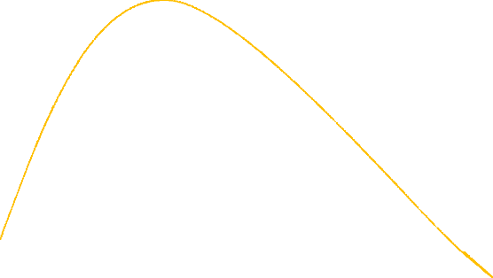
Typical Profile of the Expected Exposure
Maximum exposure
Potential exposure (at a high % level confidence)
Expected exposure
Time elapsed

Slide 7
Counterparty Risk Exposure of a Portfolio
Very often a bank has multiple trades with a counterparty. Some of the trades may be fully or partially offsetting others.
From a legal point of view, each trade must be settled separately if the counterparty’s default occurs, unless there are agreements that legally provides for otherwise (netting ageements).
Settling each trade separately means that the bank’s exposure to the counterparty E_{CPT} (t) is equal to the sum of single contract exposures:
Σ Σ
E_{CPT} (t) = E_{i} (t) = max[V_{i} (t), 0]
i i
So contracts with negative value cannot offset ones with positive value.

Slide 8
Exposure with Netting Agreement
Netting agreement is a legally binding contract between two counterparties that, in the event of default of one of them, allows aggregation of transactions before settling claims.
Derivatives with positive value at the time of default offset the ones with negative value; only the net value needs to be paid.
Suppose that there is a netting agreement between the bank and the counterparty that covers the entire portfolio.
The bank’s exposure to the counterparty is
Σ
E_{CPT} (t) = max[ V_{i} (t), 0]
i
That means that the exposure is the (net) sum of the values of all the contracts, if it is positive.

Slide 9
Multiple Netting Agreement
From a risk management point of view, a single netting agreement covering all the contracts would be an ideal solution
Nonetheless, given operational constraints, counterparties often make multiple netting agreements that cover subsets of the portfolio (some contracts may be not covered by any netting agreement)
The most general formula to indicate the counterparty-level exposure in case of multiple netting agreement is
Σ Σ Σ
E_{CPT} (t) = max[ V_{i} (t), 0] + max[V_{i} (t), 0]
j i ∈NAj i ∈/NA
where NA_{j} is the j -th netting agreement covering a specific subset of the contracts. We include in the exposure also contracts not covered by any netting agreement.

Slide 10
Collateral and Margin Agreements
Collateral agreement is a contract between two counterparties that requires one or both counterparties to post collateral under certain conditions.
Margin agreement is a legally binding collateral agreement with specific rules for posting collateral, which include:
1
Minimum transfer amount: defines the minimum amount of collateral that can be exchanged. If the exposure entails a collateral posting below the minimum, amount, no collateral is provided;
A threshold, defined for one (unilateral agreement) or both (bilateral agreement) counterparties. If the difference between the net portfolio value and already posted collateral exceeds the threshold, the counterparty must provide collateral sufficient to cover this excess (subject to minimum transfer amount);
Frequency: defines the periodicity of the exposure calculation and of the determination of the collateral to post.
2
3
The terms of the rules depend mainly on the credit qualities of the counterparties involved.

Slide 11
Exposure with Margin Agreement
We assume that every margin agreement is operating also with a netting agreement (this is usually the case).
Bank’s exposure to the counterparty is:
Σ
E_{CPT} (t) = max
j
Σ. _{Σ} Σ Σ
Σ
V_{i} (t) − C_{j} (t), 0 + max[V_{i} (t), 0]
i ∈/NA
i ∈NA_{j}
where C_{j} (t) is the market value of the collateral for netting agreement j at time t. If NA_{j} is not covered by a margin agreement, then C_{j} (t) = 0.
We have assumed the following sign convention:
1
Cj (t) > 0 : at time t the bank holds collateral in the amount |Cj (t)|;
Cj (t) < 0 : at time t the counterparty holds collateral in the amount
|Cj (t)|;
Cj (t) = 0 : at time t neither the bank nor the counterparty holds collateral.
2
3

Slide 12
Modelling Counterparty Risk Exposures Economic Capital for Counterparty Risk International Regulation for Banks
Contract-level Exposure Portfolio-level Exposure Default Modelling
Unilateral Margin Agreement
To simplify the notations, we will consider a single netting set:
E_{CPT} (t) = max[V (t) − C (t), 0]
where V (t) is the portfolio value for the netting set at time t:
Σ
V (t) = V_{i} (t)
i ∈NA
Let’s consider a unilateral margin agreement (in bank’s favor) with threshold H_{CPT} > 0 and minimum transfer amount MTA.
It is difficult to model collateral subject to MTA exactly because that would require daily simulation time points.
In practice, the actual threshold H_{CPT} is often replaced with the
effective threshold H^{e} defined as:
CPT
_{H}e
= H_{CPT} + MTA
CPT

Slide 13
Margin Period of Risk
Even with daily margin call frequency, there is a significant delay δt, known as the margin period of risk (MPR), between a margin call that the counterparty does not respond to and the start of the default procedures.
Margin calls can be disputed, and it may take several days for the bank to realize that the counterparty is defaulting rather than disputing the call
There is a grace period after the bank issues notice of default. During this grace period the counterparty may still post collateral
Thus, collateral available at time t is determined by portfolio value at time t − δt.
δt is not known with certainty, but it is usually assumed to be a fixed number:
Assumed value of δt depends on margin call frequency and trade liquidity;
Typical assumption for daily calls and liquid trades is δt = 2 weeks.

Slide 14
Including MPR in the Model
Suppose that at time t − δt we have collateral C (t − δt) and portfolio value is V (t − δt).
The amount ∆C (t) that should be posted by time t is:
∆C = max[V (t − δt) − C (t − δt) − H^{e} , −C (t − δt)]
CPT
Negative ∆C means that collateral will be received. Collateral C (t) available at time t is:
C (t) = C (t − δt) + ∆C (t) = max[V (t − δt) − H^{e} , 0]
CPT
Thus, to determine collateralized exposure at time t, we need to simulate portfolio value both at t − δt and at t.

Slide 15
Contract-level Exposure Portfolio-level Exposure Default Modelling
Full Montecarlo Algorithm
Suppose we have a set of primary simulation time points t_{k} for modeling non-collateralized exposure.
For each t_{k} > δt , define a look-back time point t_{k} − δt.
Simulate non-collateralized portfolio value along the path that includes both primary and look-back simulation times.
Given V (t_{k−1}) and C (t_{k−1}), we calculate:
1
Uncollateralized portfolio value V (tk − δt) at next look-back time
tk − δt;
Uncollateralized portfolio value V (tk ) at next primary time tk ; Collateral at tk :
2
3
C (tk ) = max[V (tk − δt) − H^{e} , 0]
CPT
4
Collateralized exposure at tk :
ECPT (tk ) = max[V (tk ) − C (tk ), 0]

Slide 16
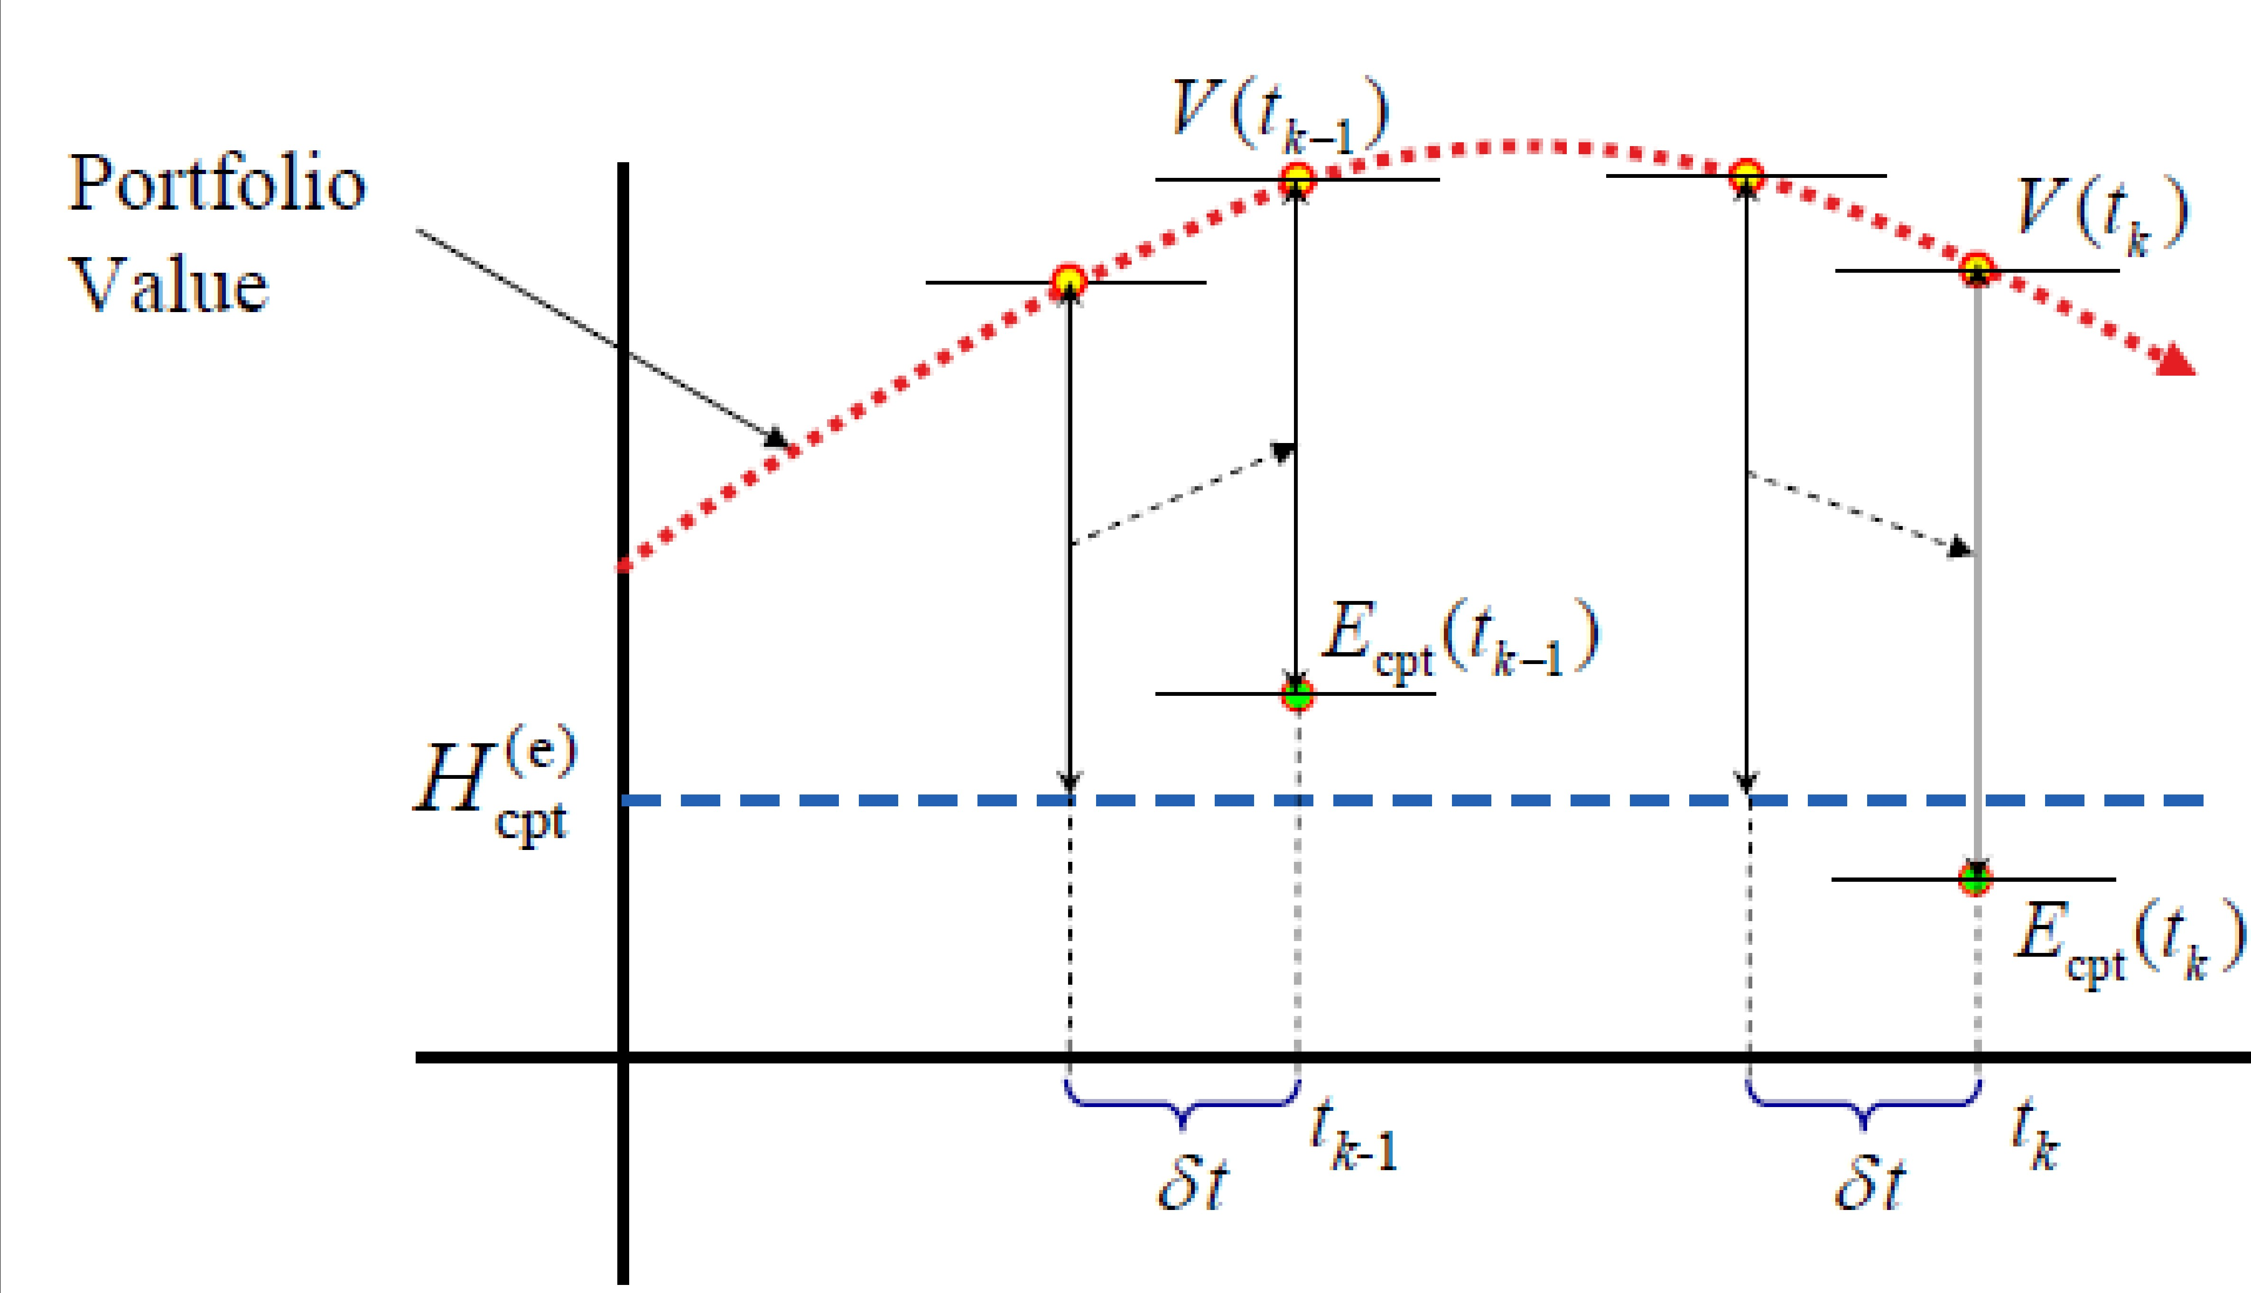
Modelling Counterparty Risk Exposures Economic Capital for Counterparty Risk International Regulation for Banks
Contract-level Exposure Portfolio-level Exposure Default Modelling
A Visual Representation of the MC Algorithm
Simulating exposure for collateralized counterparty: Collateralized exposure can go above the threshold due to MPR.

Slide 17
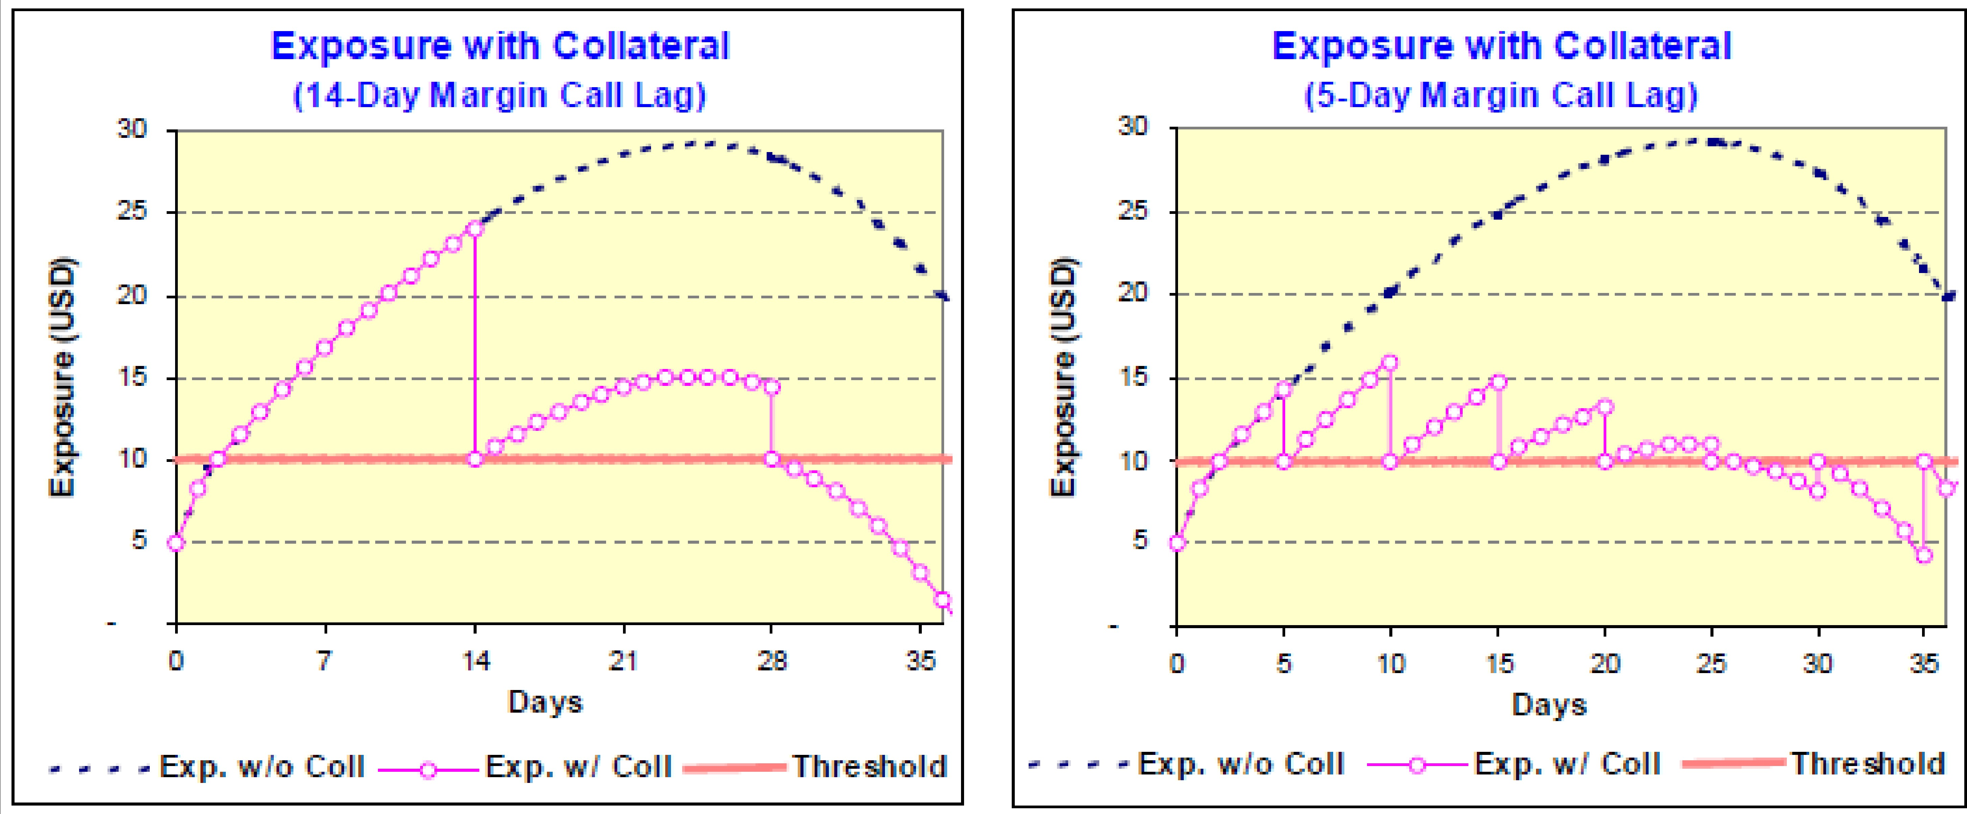
Effects of MPR on Exposures
Shorter MPR generally reduces the amount by which collateralized exposure can exceed the threshold

Slide 18
Bilateral Margin Agreement
Under a bilateral margin agreement, both the counterparty and the bank have to post collateral.
Two thresholds are defined: H_{CPT} ≥ 0 and H_{BNK} ≤ 0
H_{BNK} is negative because we value trades from the bank’s perspective;
Bank posts collateral when portfolio value falls below H_{BNK} ;
If the counterparty defaults when the bank has posted collateral, the bank should recover the posted amount when it replaces the trades.
Credit exposure comes from the potential for a significant increase of the portfolio value over the MPR.

Slide 19
Bilateral Margin Agreement
Two effective thresholds are defined:
_{H}e _{H}e
= H_{CPT} + MTA, = H_{BNK} − MTA
CPT BNK
Collateral available to bank at time t is given by:
C (t) = max[V (t − δt) − H^{e} , 0] + min[V (t − δt) − H^{e} , 0]
CPT BNK
Hence we have two types of future scenarios:
First term: the bank receives collateral: C (t) > 0;
Second term: the bank posts collateral: C (t) < 0;
We can derive which formula we have to use for counterparty exposure.

Slide 20
Bilateral Margin Agreement
Let us assume that V (t − δt) < H^{e}
so that collateral at t is:
BNK
C (t) = V (t − δt) − H^{e} < 0
BNK
If the counterparty defaults at t, the bank loses −C (t) and has to to replace the contract. We have the following cases:
1
if V (t) > 0, the bank actually pays V (t), and the net loss is
V (t) − C (t);
if C (t) < V (t) < 0, the bank receives −V (t), and the net loss is
V (t) − C (t);
if V (t) < C (t), the bank receives −V (t), but has to forward the excess over the posted collateral to the defaulting counterparty, so that the net loss is 0.
2
3
Combining all three scenarios, we recover the original formula:
E_{CPT} (t_{k} ) = max[V (t_{k} ) − C (t_{k} ), 0]

Slide 21
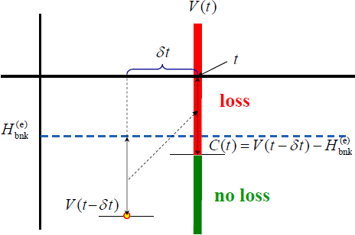
Exposures form Posting Collateral
When the bank posts collateral, it can experience loss if the portfolio
value increases by more than |H^{e} | over the MPR δt:
BNK

Slide 22
Aggregation
We have seen that to model contract-level exposure, one needs to complete two steps: scenario generation and trade valuation.
To arrive at the distribution of the counterparty-level exposure, another step is necessary: aggregation.
Aggregation process is used to calculate the counterparty-level exposure at the scenario level:
Obtain trade values calculated for a given scenario; Determine netting sets from netting agreement information;
For each netting set, calculate portfolio value. If there is a margin agreement, obtain collateralized portfolio value by calculating collateral value and subtracting it from the portfolio value.
Obtain netting-set-level exposure by applying zero floor to portfolio value.
Obtain counterparty-level exposure by adding netting-set-level exposures

Slide 23
Market Factors According to Contracts
When computing the counterparty exposure measures, market risks to consider depend on the underlying of the contracts and the nature of the latter. Some examples are summarized in the following table:
 |  | Risk Factors by Contract’s Nature
Instruments |  | Spot / Fwd | Short Dated Plain Vanilla Options | Long Dated Plain Vanilla Options | Exotic Options | Hybrid
FX Rates – Implied Volatility
– Interest Rate
FX Rates – Implied Volatility (Smile) – Correlation
Asset Price – Correlation – Implied Volatility
FX
FX Rates
FX Rates
Interest Rate Curve (IRC) – Spread Curve
Interest Rate Curve (IRC) – Spread Curve
- Implied Volatility
Interest Rate Curve (IRC) – Implied Volatility (Cube) - Correlation
Interest Rate Curve (IRC) – Spread Curve
Assets Prices – Correlation – Implied Volatility
IR
Stock Prices – Implied Volatility
– Interest Rate
Dividends
Stock Prices – Implied Volatility (Smile) – Dividends
- Correlation
Assets Prices – Correlation – Implied Volatility
EQ
Stock Prices
Stock Prices

Slide 24
Scenarios’ Generation
In order to obtain contracts values and counterparty exposure measures,a Montecarlo simulation (MC) is run according to the following criteria:
the number of simulation dates is fixed at k. A fixed
non-homogeneous time grid will be chosen so as to minimize roll-off
risk
at each simulation date, some thousands scenarios are generated for each of the market risk factors of the portfolio
future market scenarios are simulated using evolution models for each risk factor
evolutions models for risks will be calibrated to prices available at the time of evaluation
if no risk factor market value is available, historical data (e.g., volatilities or correlations) will be used

Slide 25
Valuation Algorithms
Once the scenarios are generated, the pricing of the contracts and the counterparty exposures measurement can be performed with models already internally developed or by models to be specifically designed
Some possible ways to minimize computation time are here listed:
When possible, one resorts to closed form formulae, ad-hoc models for specific contracts, analytical approximations
Specific numerical procedure can be designed so that only one multi-step MC simulation, up to the longest expiry in the reference portfolio, has to be run: future prices of the contracts are then estimated on the pre-defined steps with some approximation rules
An optimization of the number of steps is operated according to the portfolio’s cash-settlement dates and risk-mitigation related dates.
The result of the procedure is the expected exposure for the counterparty EE_{i} (t_{k} ) at times {t_{k} }.
Remark: All the contracts with a specific counterparty will be aggregated according to the types of credit risk mitigation agreement (netting, collateral) actually operating.

